Slide 1
Position-Based Fluid Simulation
Samantha Cohen
Sarah Leung

Slide 2
Implementation

Slide 3
Overview of Position-Based Fluids
Solves density constraint, a function of the particle and its neighbors, to enforce incompressibility
Uses a Jacobi solver for constraint projection
Neighbor search implemented using spatial hashing to find particles within a certain radius of each other
Static collision detection and response implemented with a bounding box and OBJ meshes
Kernel functions used to determine the weight of each neighbor on the particle

Slide 4


Kernel Calculations
Spiky Kernel for pressure calculations
Poly6 Kernel for all other calculations

Slide 5
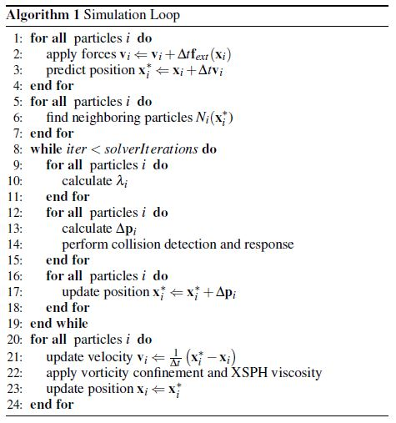
Algorithm (Macklin and Muller, 2013)

Slide 6
Algorithm (Macklin and Muller, 2013)
Add external forces, in our case gravity, to each particle’s velocity

Slide 7
Algorithm (Macklin and Muller, 2013)
Find predicted particle position based upon velocity

Slide 8
Algorithm (Macklin and Muller, 2013)
Perform neighborhood search to find all particles within a certain radius of the current particle

Slide 9
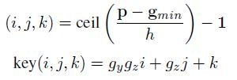
Neighborhood Search with Spatial Hashing
We used spatial hashing to create a grid to quickly access particles’ neighbors
The grid is discretized into cells, with width h equal to the neighborhood radius
Each particle’s grid coordinates are determined and hashed to a scalar key, with neighborhood radius h, minimum grid cell coordinates gmin, and grid dimensions g

Slide 10
Algorithm (Macklin and Muller, 2013)
Calculate Lambda, a variable needed to find the position delta of each particle

Slide 11




Lambda Calculation
Calculate particle density based upon neighbors using the poly6 kernel
Calculate particle constraint based upon particle density and rest density
Calculate particle constraint delta using the spiky kernel gradient
Calculate lambda based upon calculated constraints
(1)
(2)
(3)
(4)

Slide 12
Algorithm (Macklin and Muller, 2013)
Calculate position delta, which will simulate pressure, for each particle

Slide 13



Position Delta & Pressure Calculation
The position delta per particle can be calculated based upon lambda calculations and using the gradient of the spiky kernel
However, a tensile instability term found using the poly6 kernel can be calculated, adding an artificial pressure to each particle
The final position delta adds the Scorr term to the calculation
(1)
(2)
(3)

Slide 14
Algorithm (Macklin and Muller, 2013)
Detect and resolve collisions between particles that hit the bounding box or OBJ meshes

Slide 15
Collision Detection & Response
We used static collision detection within the bounding box where the predicted position is updated to the inner surface of the bounding box and the velocity is reflected with a coefficient of restitution
OBJ static mesh collision was detected using particle-triangle intersection
OBJ collision detection was optimized by first performing an intersection test with the bounding box of the mesh
In our implementation we moved collision detection out of the solver loop, because we found that we could not update the velocity as required within the loop, so we moved it to after the XSPH viscosity calculation

Slide 16
Algorithm (Macklin and Muller, 2013)
Update the predicted position to include position delta, which simulates pressure

Slide 17
Algorithm (Macklin and Muller, 2013)
Update the velocity based upon the current particle position and predicted position

Slide 18
Algorithm (Macklin and Muller, 2013)
Apply vorticity (optional) and viscosity using XSPH

Slide 19



Vorticity Confinement
We decided not to use vorticity confinement in our water simulation because it made the simulation unstable and did not appear to improve the overall quality of the simulation
However, when we tried it out we used the following calculations
(1)
(2)
(3)
(4)
(5)

Slide 20

XSPH Viscosity
XSPH is used to simulate viscosity and is calculated using the poly6 kernel
(1)
(2)

Slide 21
Algorithm (Macklin and Muller, 2013)
Update current particle position to the predicted position

Slide 22
OBJ Loading
We wrote an OBJ loader that reads .obj files and saves individual triangle objects that have three associated vertices, normal, and color attributes
Before the algorithm loop executed, the OBJ mesh would load, and collision detection and response would then also be applied to the OBJ

Slide 23
Particle Export
After the algorithm completed after each iteration, we used a method to export particle positions to a .txt file, taken from https://raw.githubusercontent.com/christopherbatty/Fluid3D/master/main.cpp
//Modified from https://raw.githubusercontent.com/christopherbatty/Fluid3D/master/main.cpp
void export_particles(string path, int frame, const WaterSim ws, float radius) {
//Write the output
std::stringstream strout;
strout << path << "particles_1000_bunny_" << frame << ".txt";
string filepath = strout.str();
ofstream outfile(filepath.c_str());
//write vertex count and particle radius
outfile << ws.particleList.size() << " " << radius << std::endl;
//write vertices
for(unsigned int i = 0; i < ws.particleList.size(); ++i)
outfile << ws.particleList.pos(i)[0] << " " << ws.particleList.pos(i)[1] << " " << ws.particleList.pos(i)[2] << std::endl;
outfile.close();
}

Slide 24
Particle Importing into Maya
In Maya, we created the same number of sphere primitives as there were particles in the scene.
We then wrote a MEL script to read through each individual particle position .txt file and update the position of each individual sphere based upon these positions, and then save a key frame after file reading was completed

Slide 25
MEL Script
global proc moveWater(int $i_frame_max, int $particle_num)
{
for( $i=1; $i<$i_frame_max; $i++ )
{
$water_file = "C:/Users/Samantha/Documents/WaterSim/particles_" + $i + ".txt";
$file = `fopen $water_file "r"`;
$temp=(int)$i;
currentTime $temp;
string $nextLine = `fgetline $file`;
$meshes = `ls -type "mesh"`;
for( $j = 1; $j < $particle_num; $j++ )
{
$mesh = "pSphere" + $j;
string $rawAnimArray[];
$nextLine = `fgetline $file`;
tokenize ($nextLine, " ", $rawAnimArray);
float $x = $rawAnimArray[0];
float $y = $rawAnimArray[1];
float $z = $rawAnimArray[2];
setAttr ($mesh+".translateX") $x;
setKeyframe ($mesh+".translateX");
setAttr ($mesh+".translateY") $y;
setKeyframe ($mesh+".translateY");
setAttr ($mesh+".translateZ") $z;
setKeyframe ($mesh+".translateZ");
}
fclose $file;
}
};
moveWater(185,8000);

Slide 26
Challenges

Slide 27
Challenges Faced
Parameter tuning was a challenge, as it took us a while to find the appropriate constants for mass, etc. to make the simulation run without explosions
We had the same issue once we implemented OBJ mesh collisions
The following videos show our struggle with parameter tuning

Slide 28
Challenges Faced
Running time was difficult to optimize because we have spheres created using VBOs drawing every time the particle positions are updated, which takes extra processing time
We implemented spatial hashing for neighborhood search to decrease running time, and decreased the number of calls to the vector push_back method
We were able to get close to a real-time simulation but it is still a tad slow
The following videos are a real-time comparison of spheres vs. GL_POINTS drawing the particles

Slide 29
Work Completed

Slide 30
Work Completed
We created a working water simulation that is stable when it hits the ground and mostly stable for OBJ mesh collisions
We created videos recorded from our program of the water simulation colliding with the ground and OBJ meshes, with spheres colored according to their velocity
We created videos rendered in Maya using our MEL script and the particle positions calculated from our water simulation
All of this can be seen in the following videos

Slide 31
References
[1] [Macklin & Muller 2013] Position Based Fluids
[2] [Muller et al. 2006] Position Based Dynamics
[3] [Muller et al. 2003] Particle-Based Fluid Simulation for Interactive Applications
[4] https://raw.githubusercontent.com/christopher
batty/Fluid3D/master/main.cpp

